Slide 1
IT Project
Management
Instructor: Tran Vinh Khiem
March 1st, 2020
S³T
Smart Software System Team

Slide 2

“Being a Project Manager is like being an artist, you have the different colored process streams combining into a work of art.”
– Greg Cimmarrusti
IT Project Management

Slide 3
Learning Objectives
Understand the basic definition of Control system, Version control system, Distributed version control system
Understand and know how to use Git
Understand what is Github and some alternatives.

Slide 4
Resource management
Control System: This basically means that Git is a content tracker. So Git can be used to store content — it is mostly used to store code due to the other features it provides. (Freecodecamp)
Version control system, or VCS, tracks the history of changes as people and teams collaborate on projects together. As the project evolves, teams can run tests, fix bugs, and contribute new code with the confidence that any version can be recovered at any time.
Git is an example of a distributed version control system (DVCS) commonly used for open source and commercial software development. DVCSs allow full access to every file, branch, and iteration of a project, and allows every user access to a full and self-contained history of all changes.
Notes:
What is version control | Atlassian Git Tutorial
An introduction to Git: what it is, and how to use it (freecodecamp.org)
Git Handbook · GitHub Guides
The-Git-Tutorial.ppt - Google Slides
Stack Overflow Developer Survey 2020

Slide 5
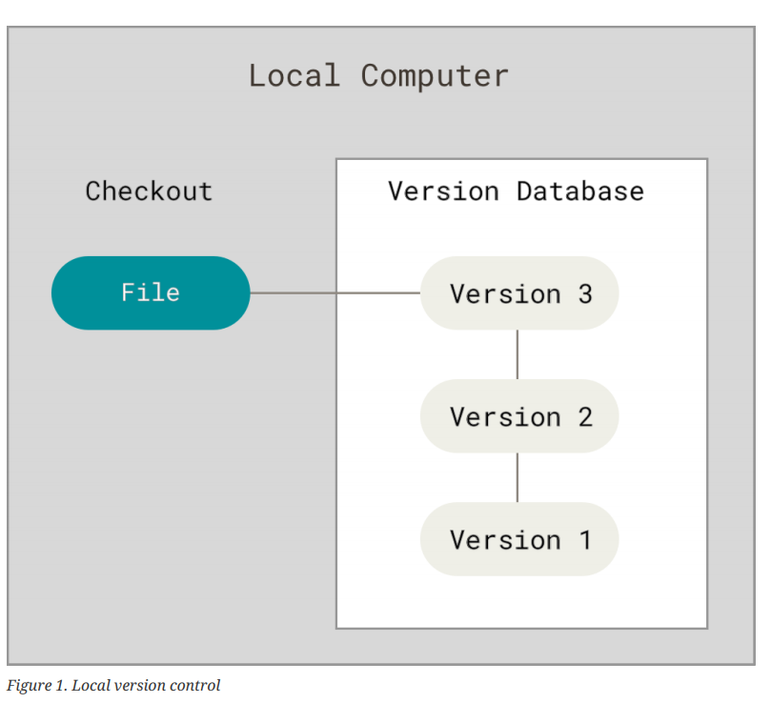
Version control

Slide 6
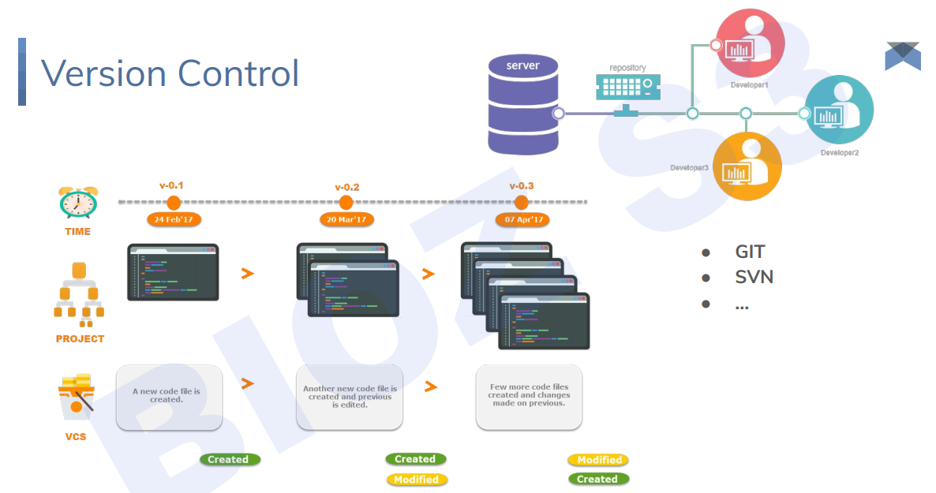

Slide 7
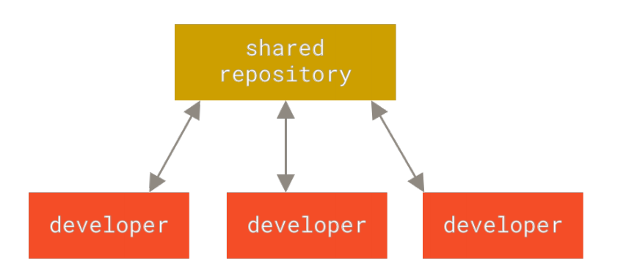
Version control

Slide 8
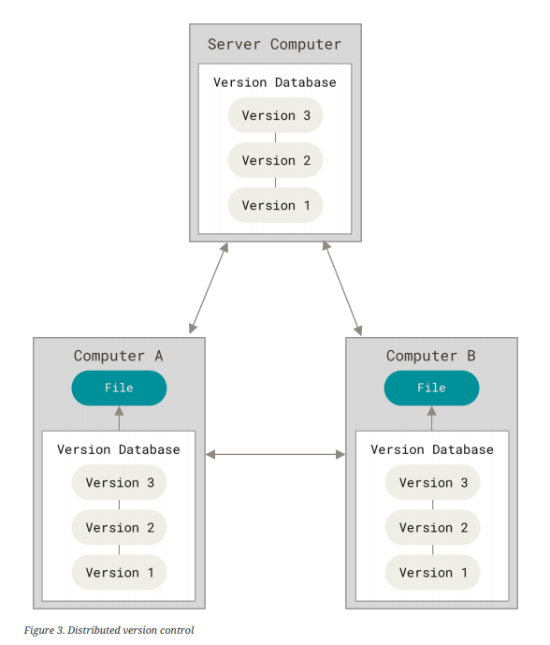
Distributed Version control
Notes:
90% use Git – Bitbucket
Mercurial stop supporting on Bitbucket
Bazaar is written by Python

Slide 9



Distributed Version control
Notes:
90% use Git – Bitbucket
Mercurial stop supporting on Bitbucket
Bazaar is written by Python

Slide 10
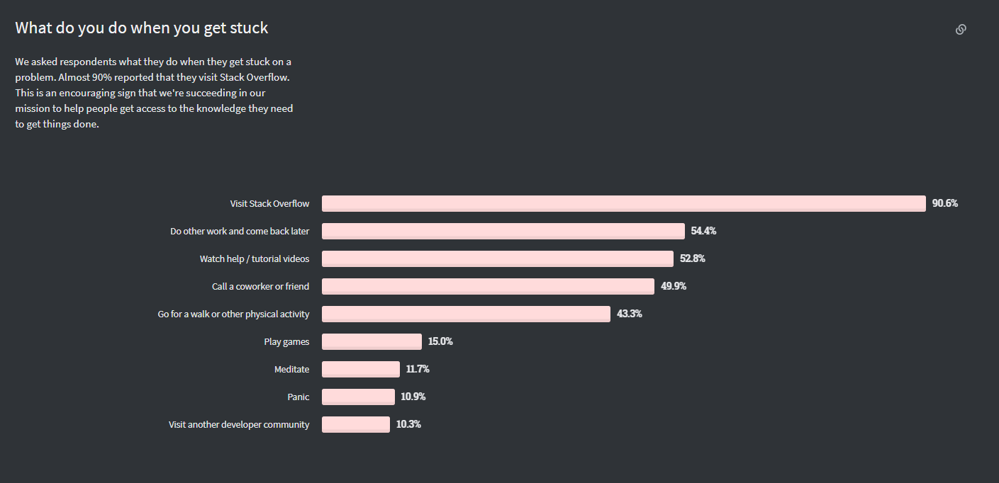
Git

Slide 11

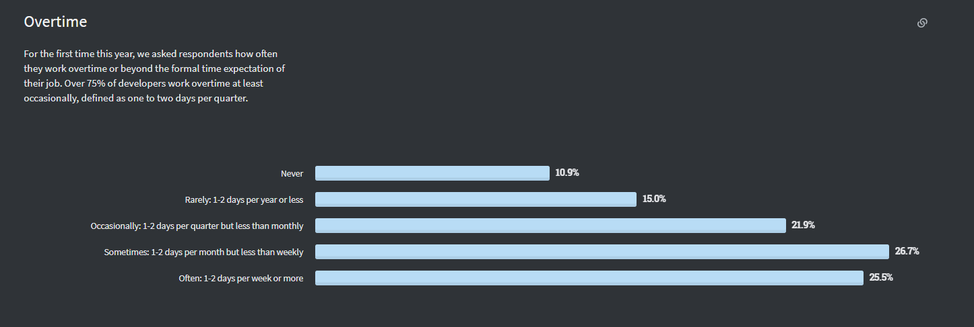

Slide 12
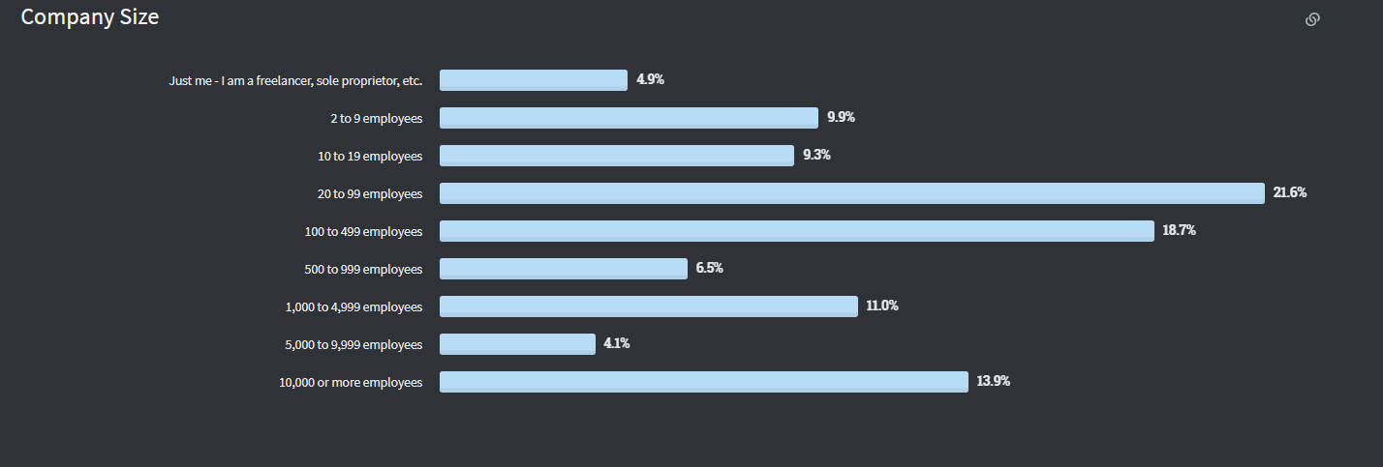

Slide 13
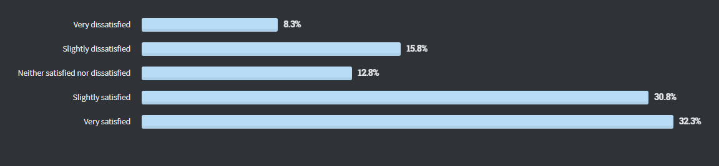

Slide 14
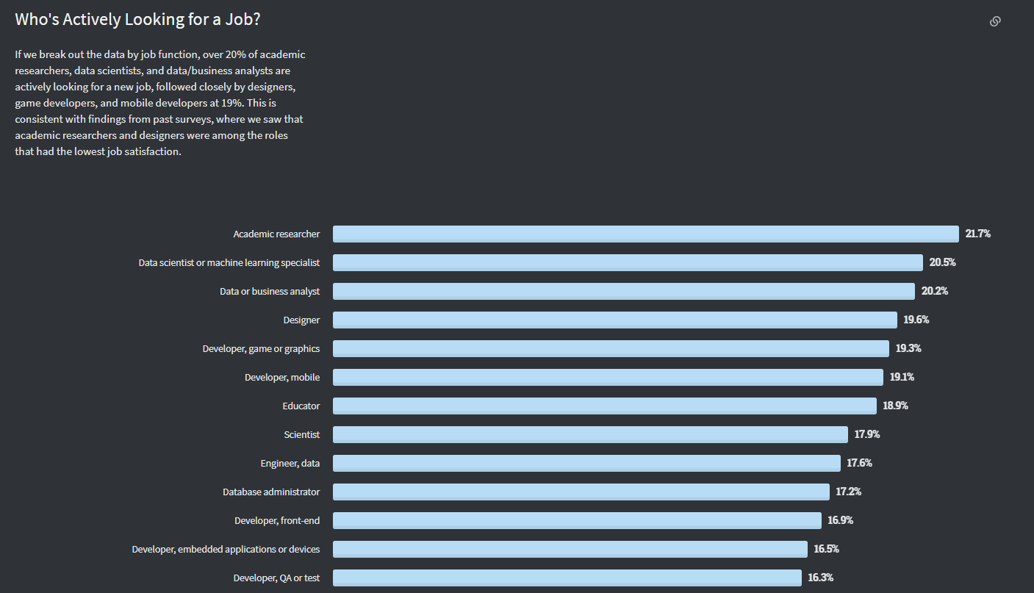

Slide 15
Git
Help developers roll back and collaborate with others.
Git is not Github
Git can work on Linux, Mac and Windows.
Git has integrity

Slide 16
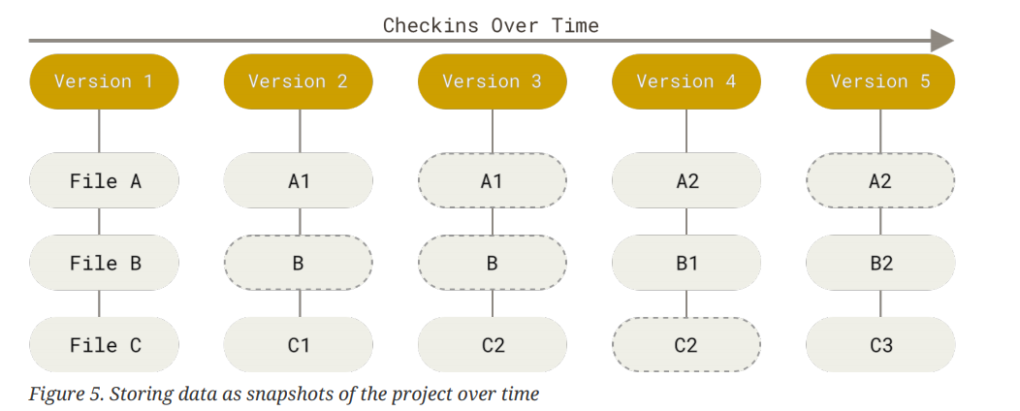
Git

Slide 17
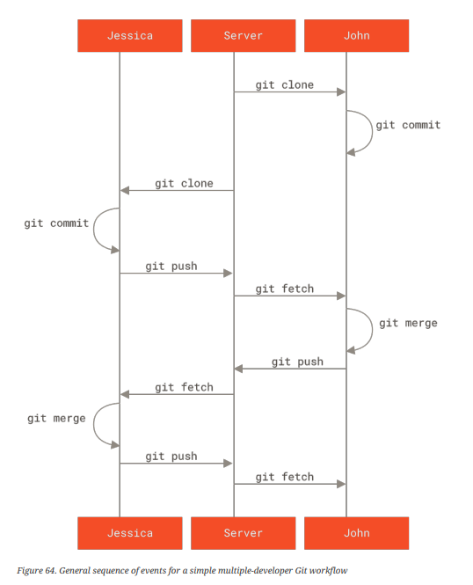
Git

Slide 18
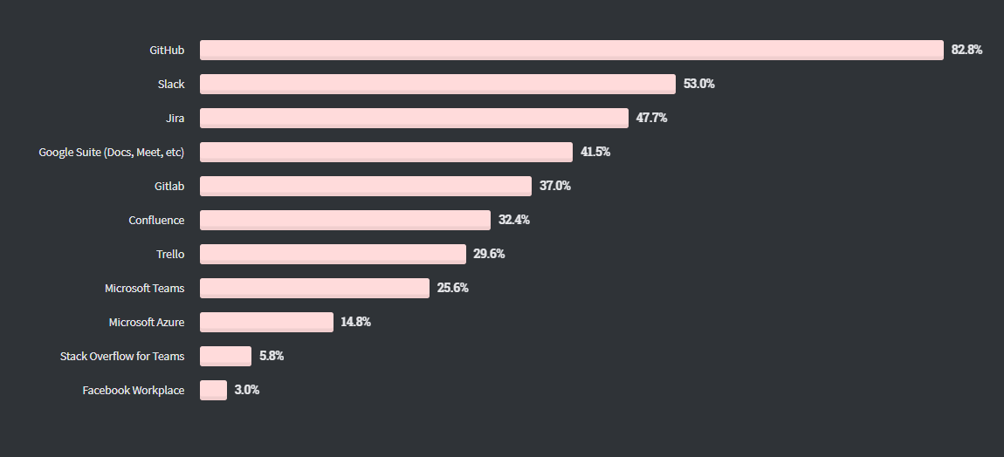
Github

Slide 19
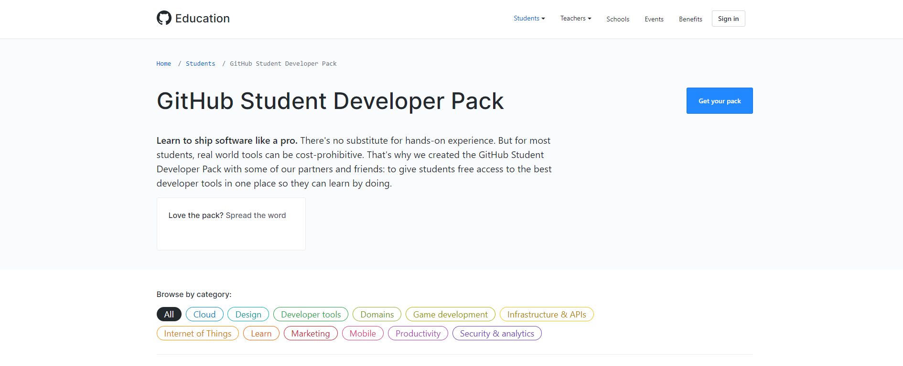
Github Student Pack
Access to this link : GitHub Student Developer Pack - GitHub Education
Click on get your pack

Slide 20
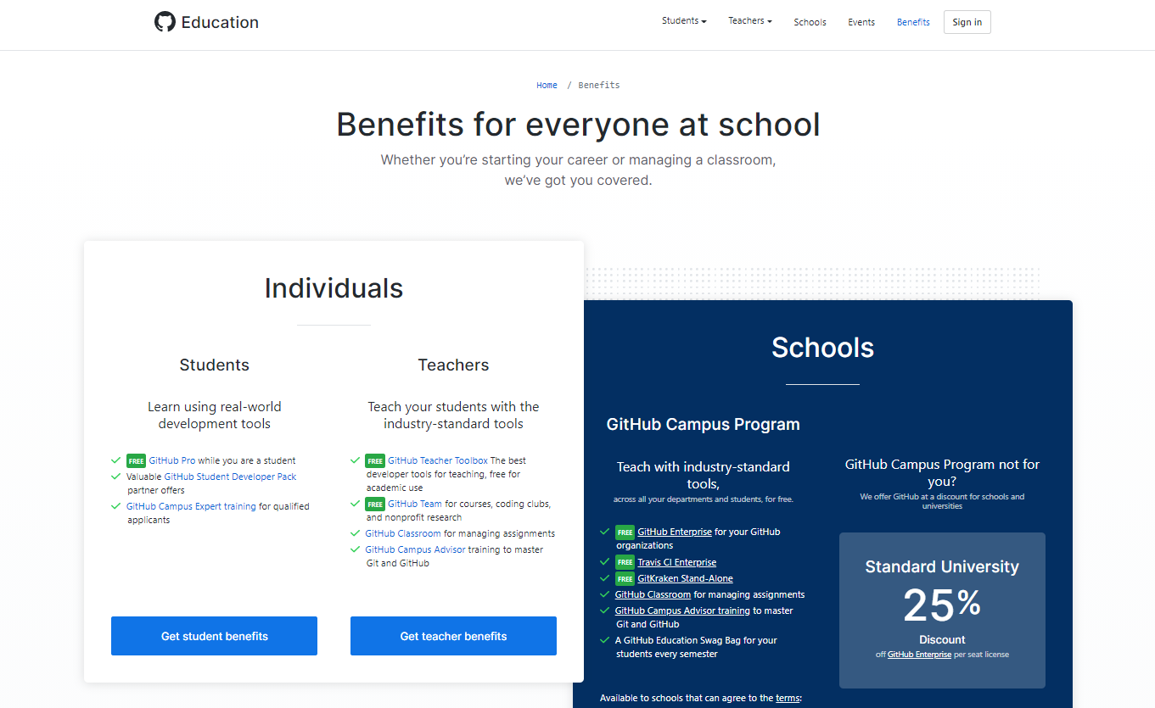
Github Student Pack
Click on get student benefit

Slide 21
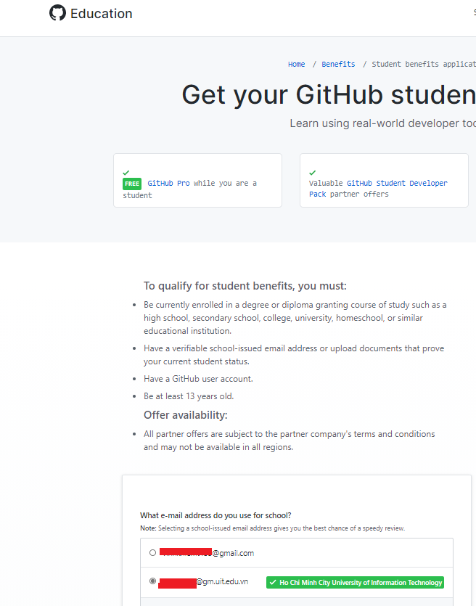
Github Student Pack
Click on get student benefit

Slide 22
Exercise – Install git
Linux: Git (git-scm.com)
Mac: Git - Downloading Package (git-scm.com)
Window: Git - Downloading Package (git-scm.com)

Slide 23
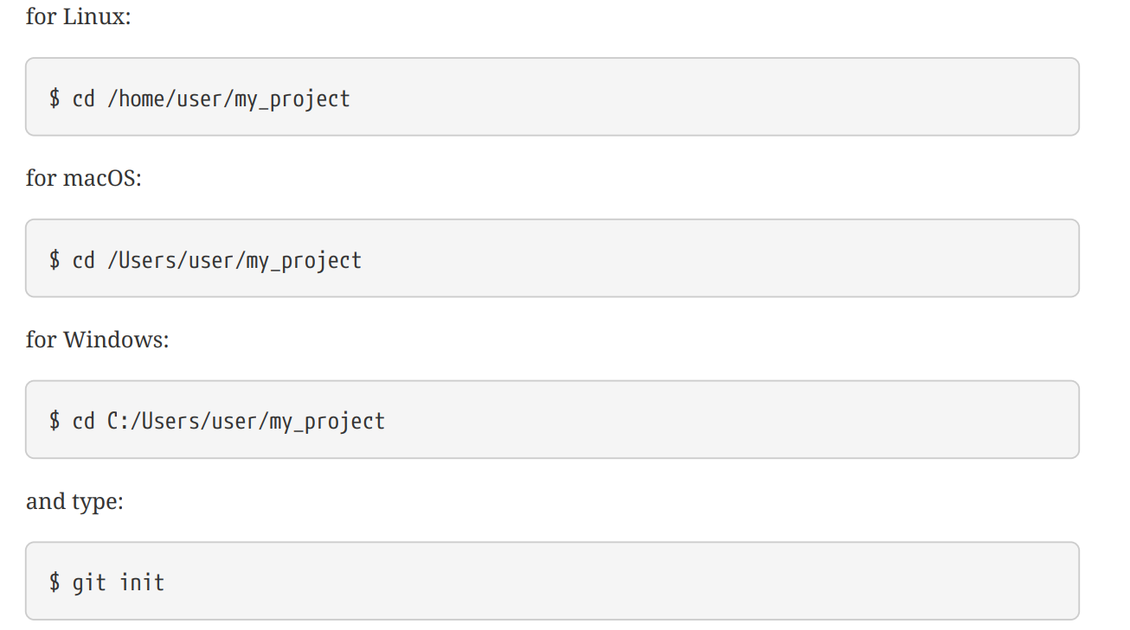
Exercise – Init Repo in an existing directory

Slide 24
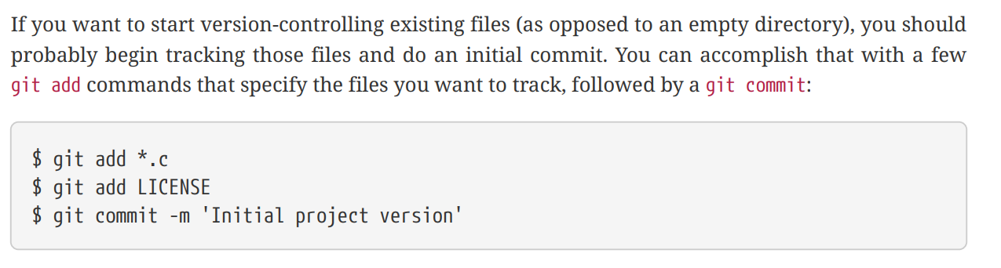
Exercise – Git add, git commit

Slide 25
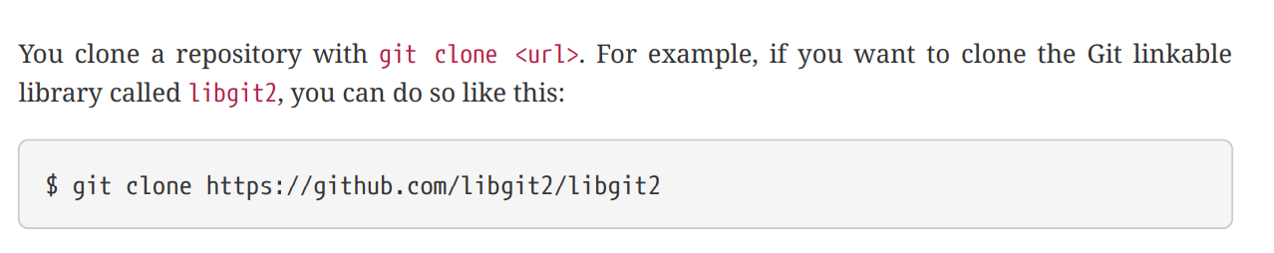
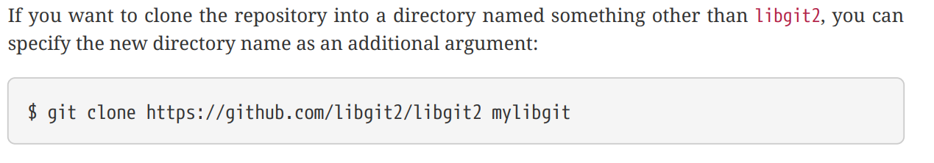
Exercise – Git clone

Slide 26
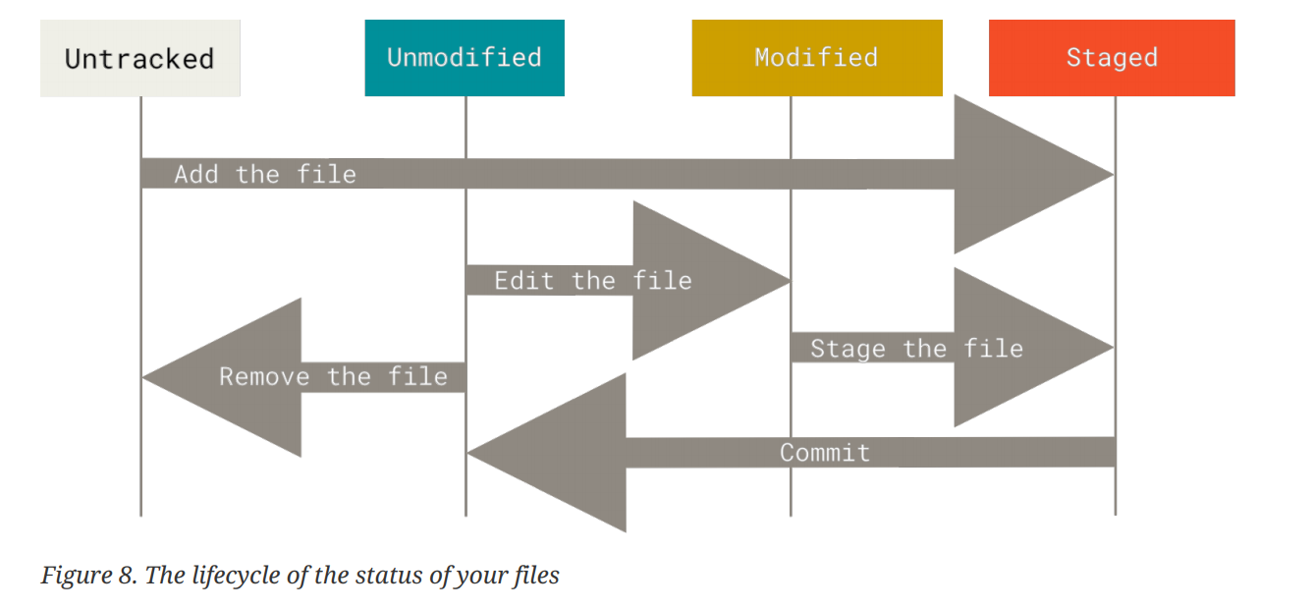
Life ctyle of files

Slide 27
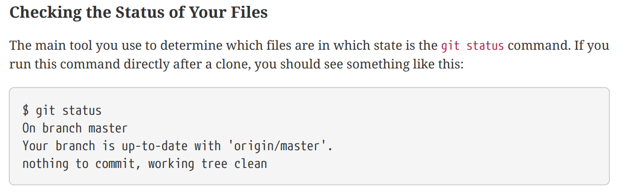
Exercise – Git status

Slide 28
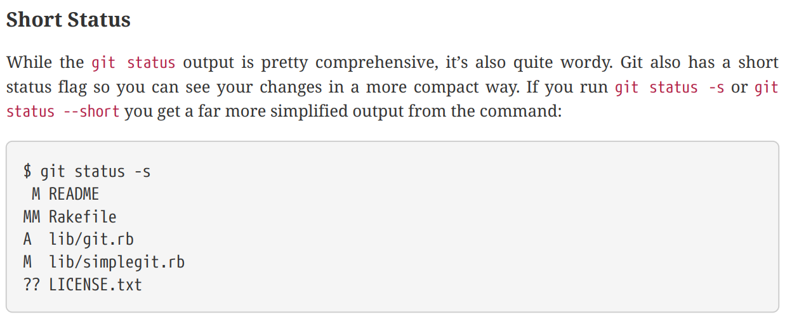
Exercise – Git short status

Slide 29
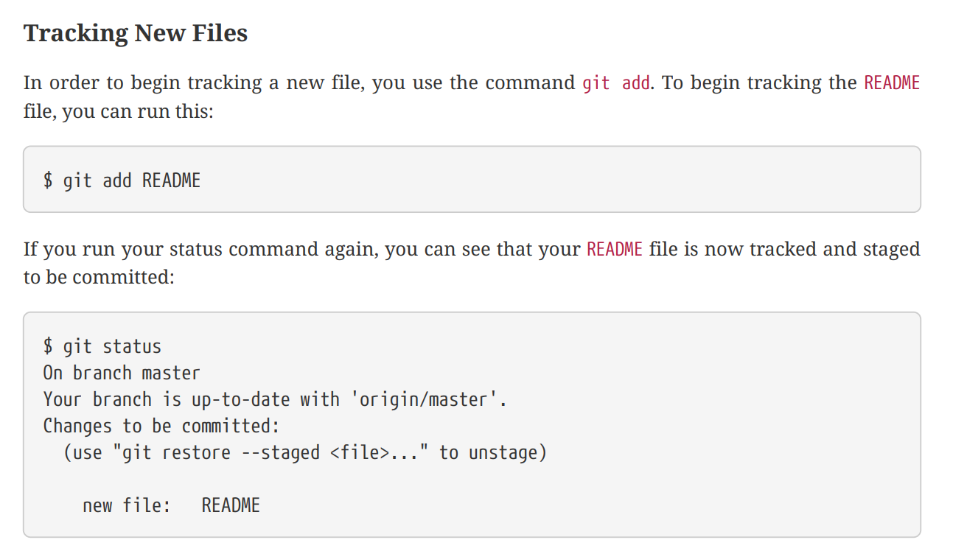
Exercise – Stage modified file

Slide 30
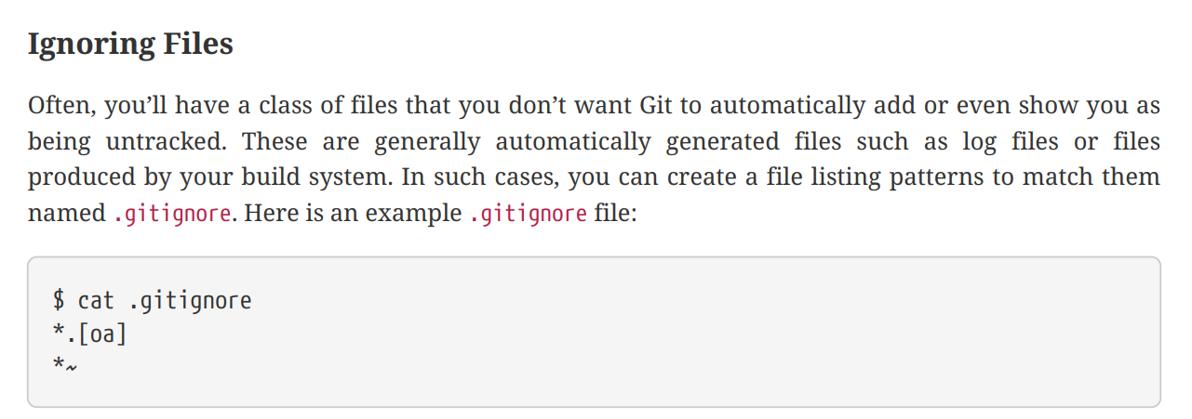
Exercise – Ignoring Files

Slide 31
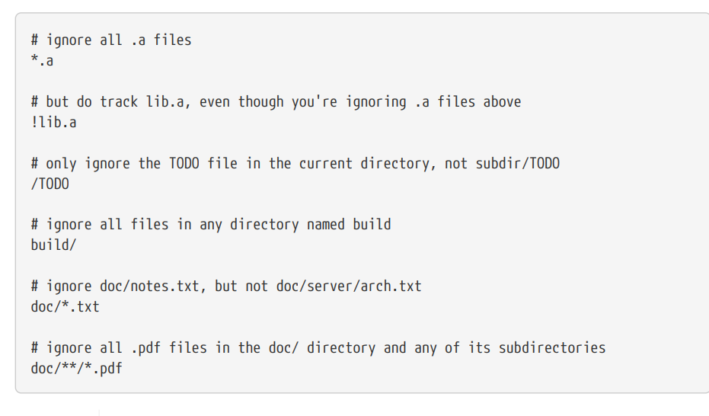
Exercise – Ignoring Files

Slide 32
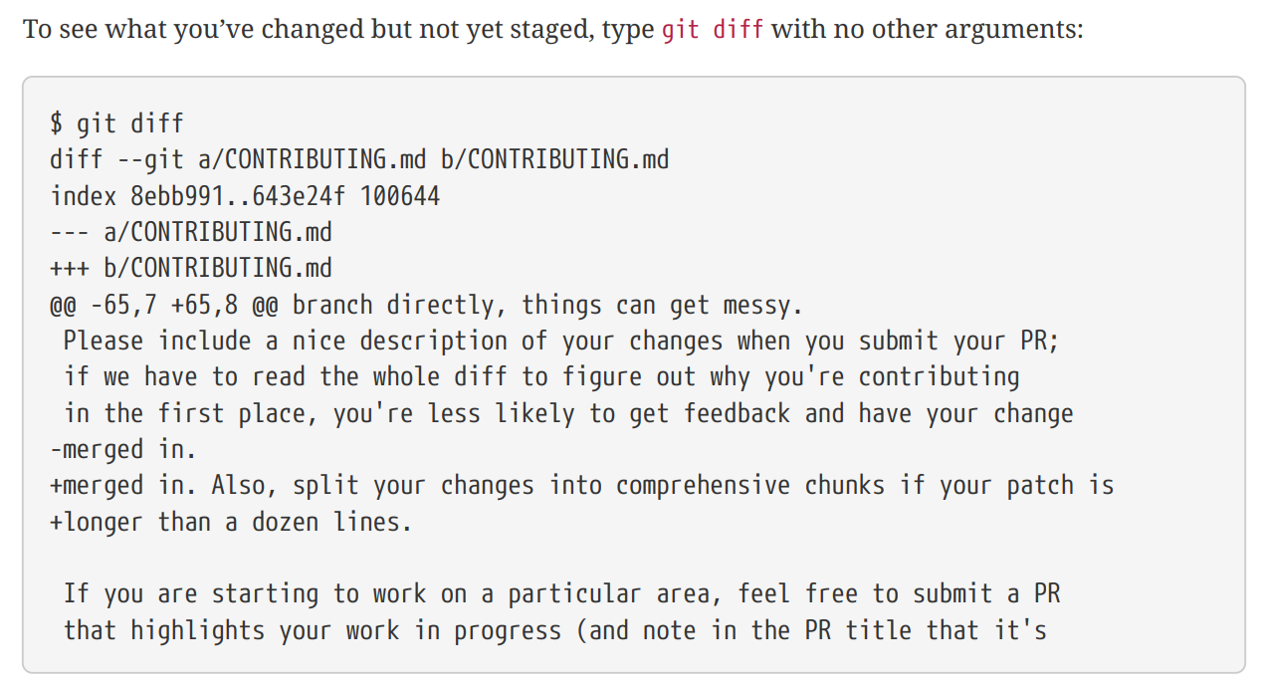
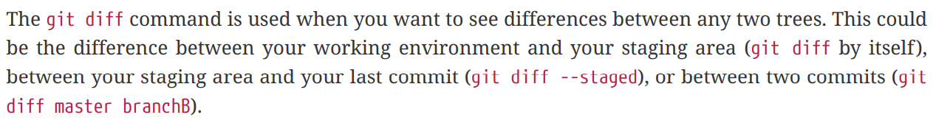
Exercise – Viewing Your Staged and Unstaged Changes

Slide 33
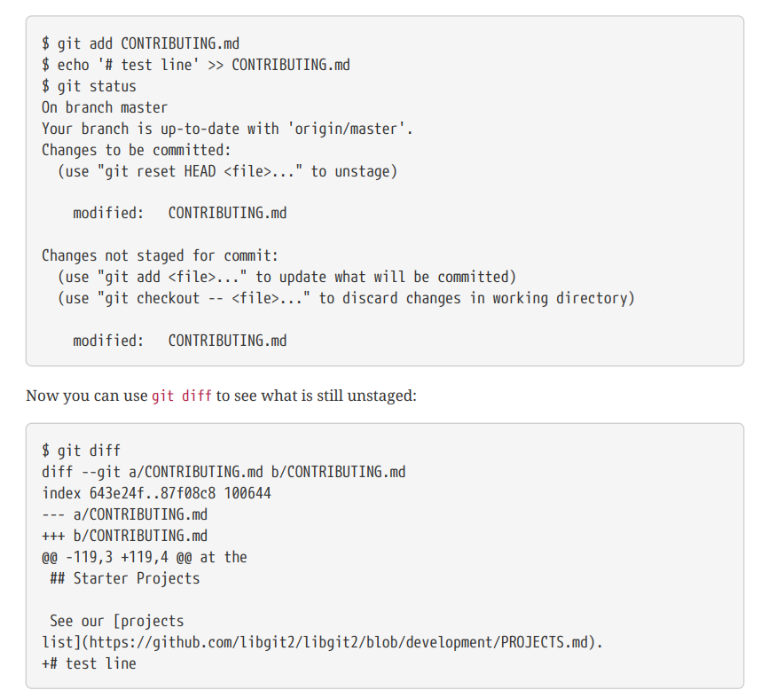
Exercise – Viewing Your Staged and Unstaged Changes

Slide 34
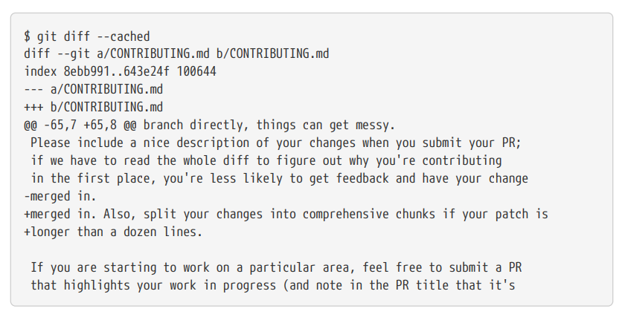
Exercise – Viewing Your Staged and Unstaged Changes

Slide 35
Exercise – Viewing Your Staged and Unstaged Changes

Slide 36
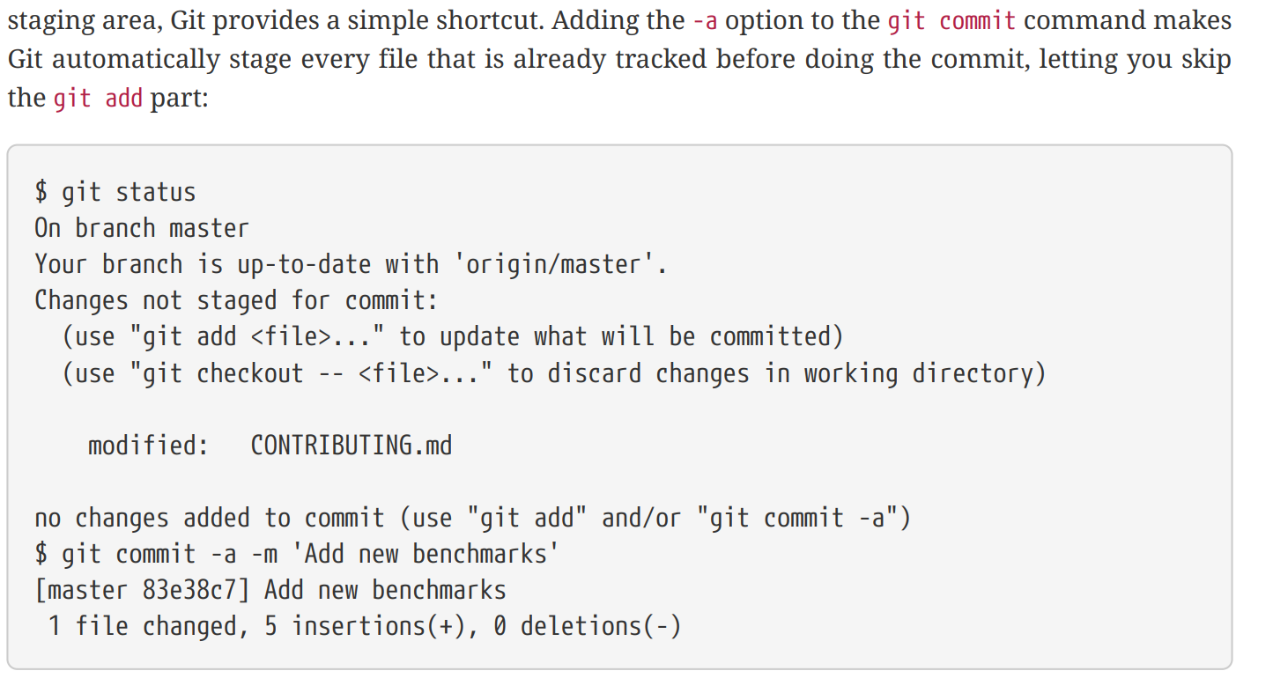
Exercise – Skipping the Staging Area

Slide 37
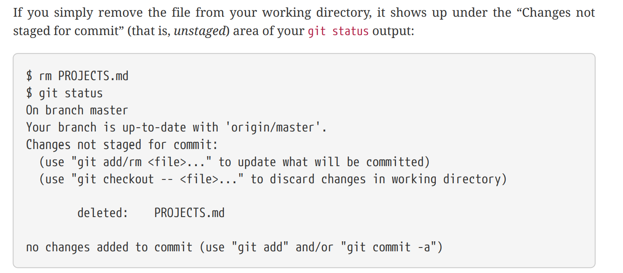
Exercise – Removing files.

Slide 38
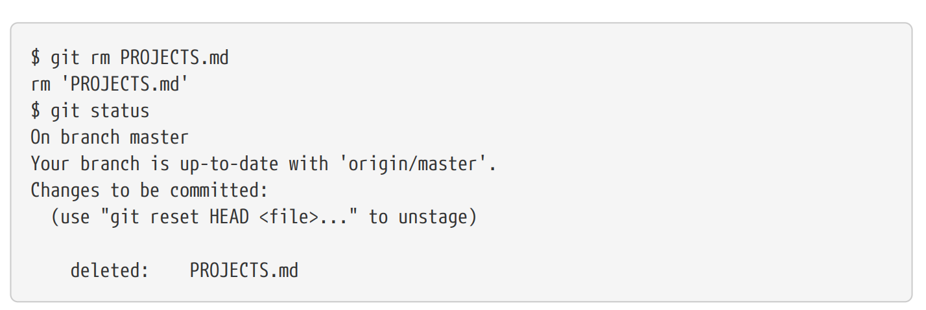
Exercise – Removing files.

Slide 39
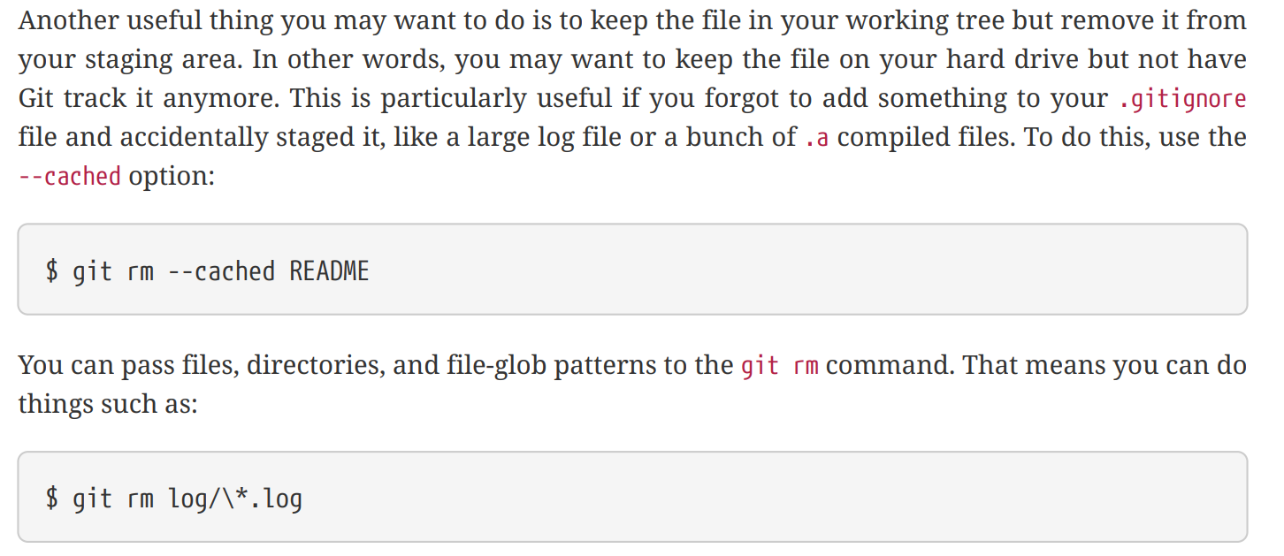
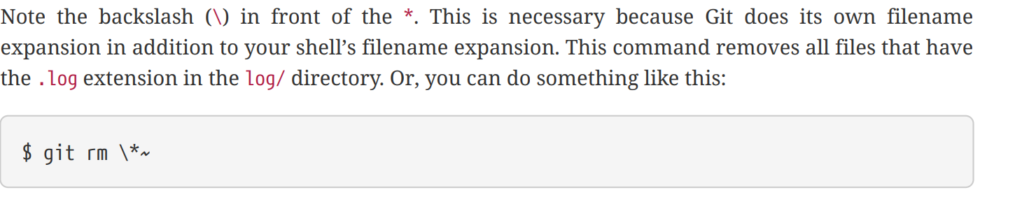
Exercise – Removing files.

Slide 40
Exercise – Removing files.

Slide 41
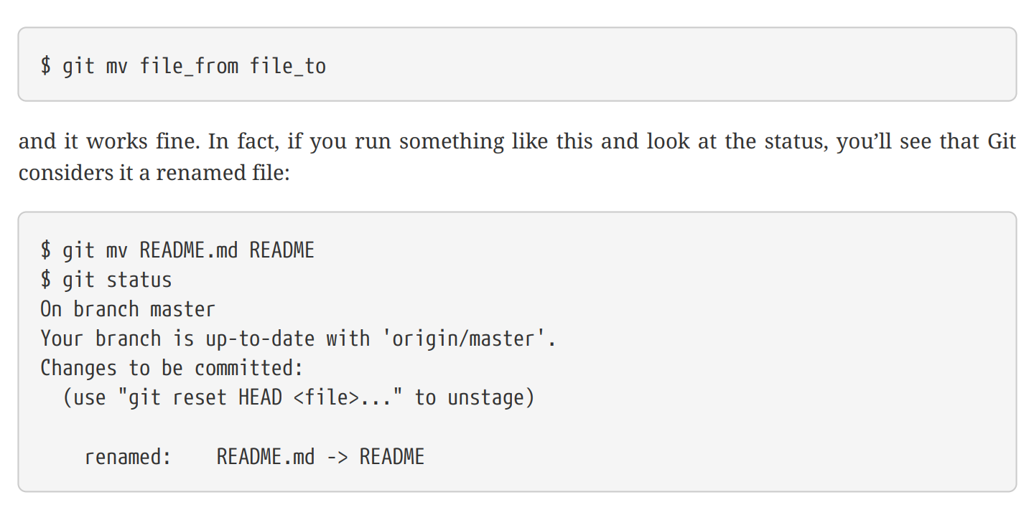
Exercise – Moving files.

Slide 42
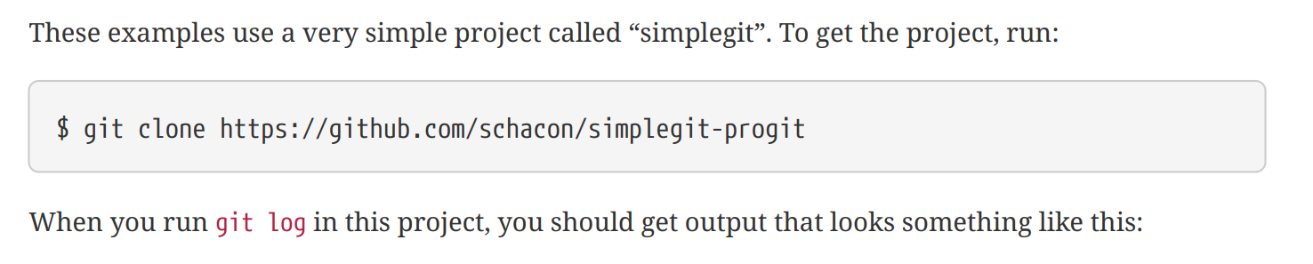
Exercise – Viewing the Commit History

Slide 43
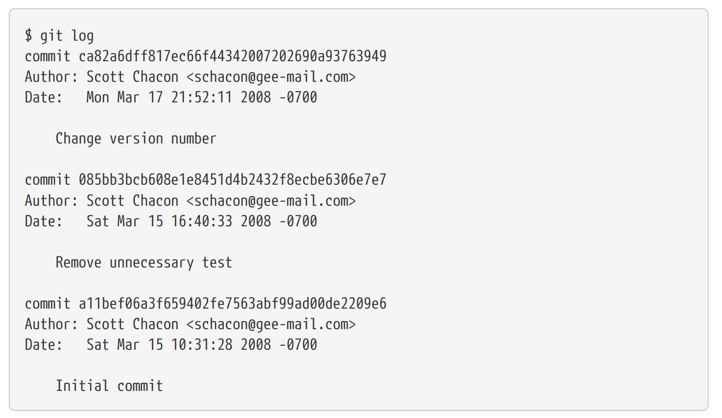
Exercise – Viewing the Commit History

Slide 44
Exercise – Viewing the Commit History

Slide 45
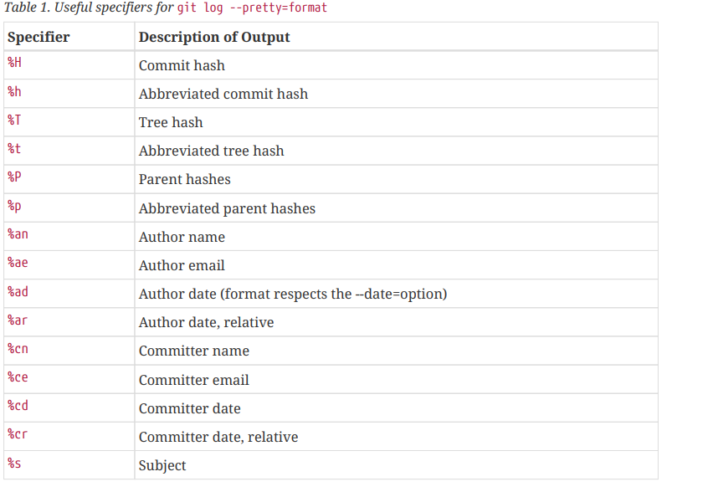
Exercise – Viewing the Commit History

Slide 46
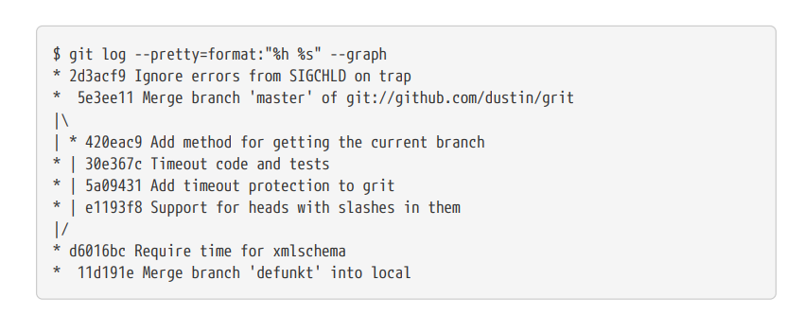
Exercise – Viewing the Commit History

Slide 47
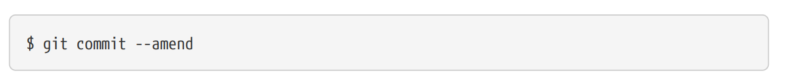
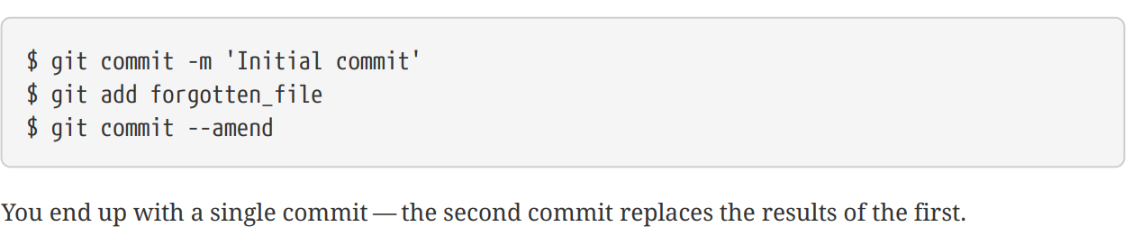
Exercise – Undoing Things

Slide 48
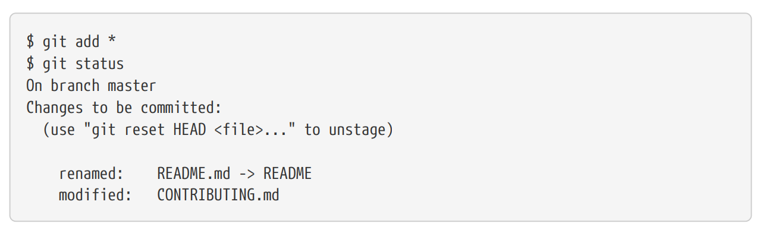
Exercise – Undoing Things

Slide 49
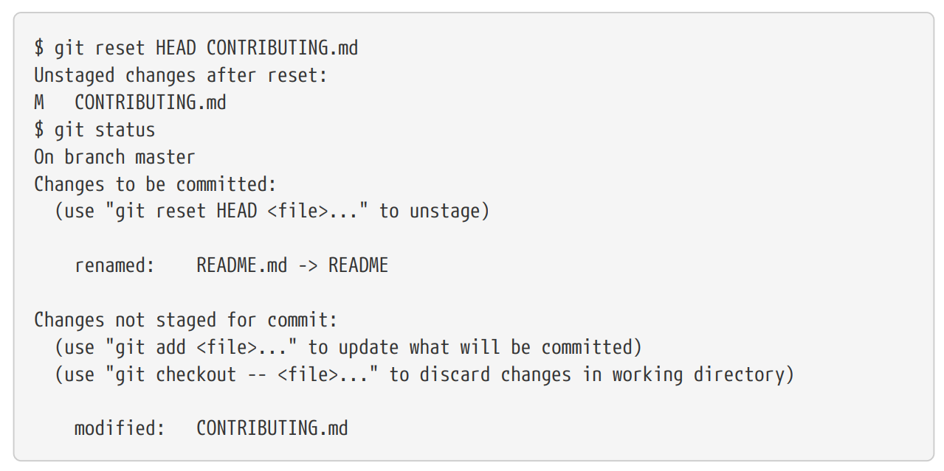
Exercise – Undoing Things

Slide 50
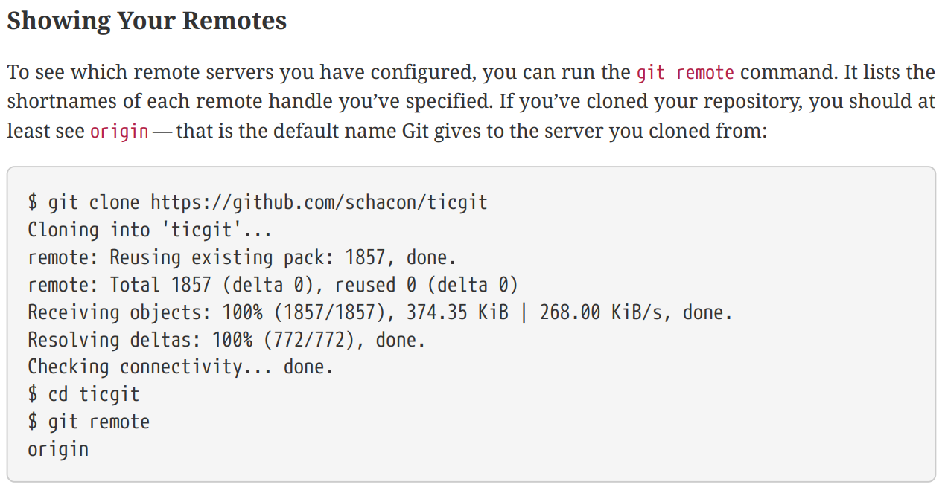
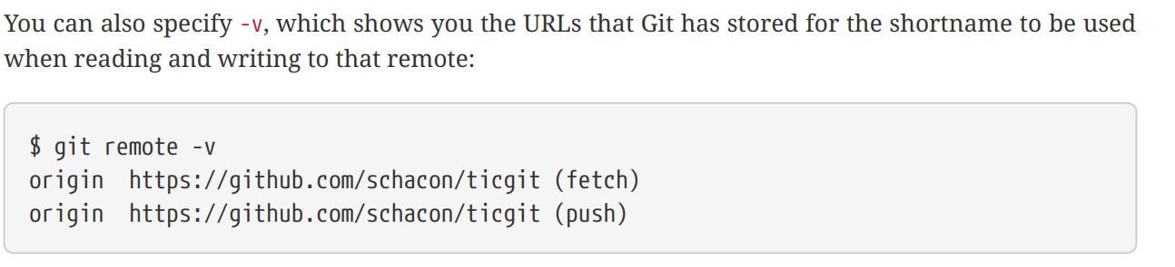
Exercise – Working with Remotes

Slide 51
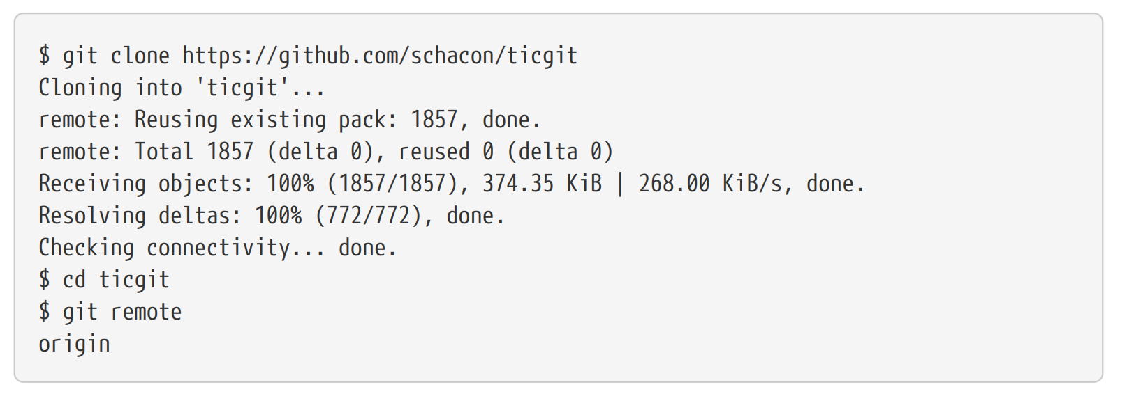
Exercise – Working with Remotes

Slide 52
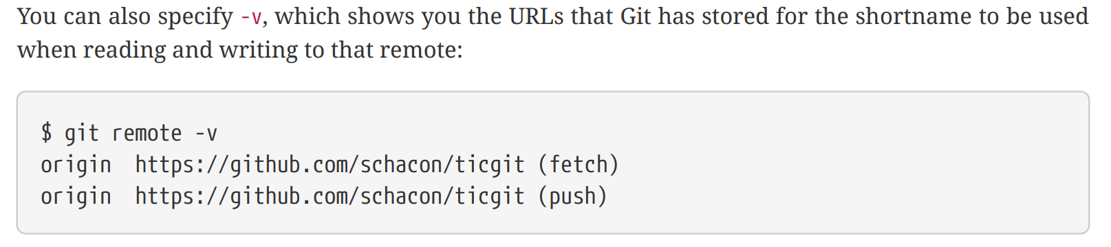
Exercise – Working with Remotes

Slide 53
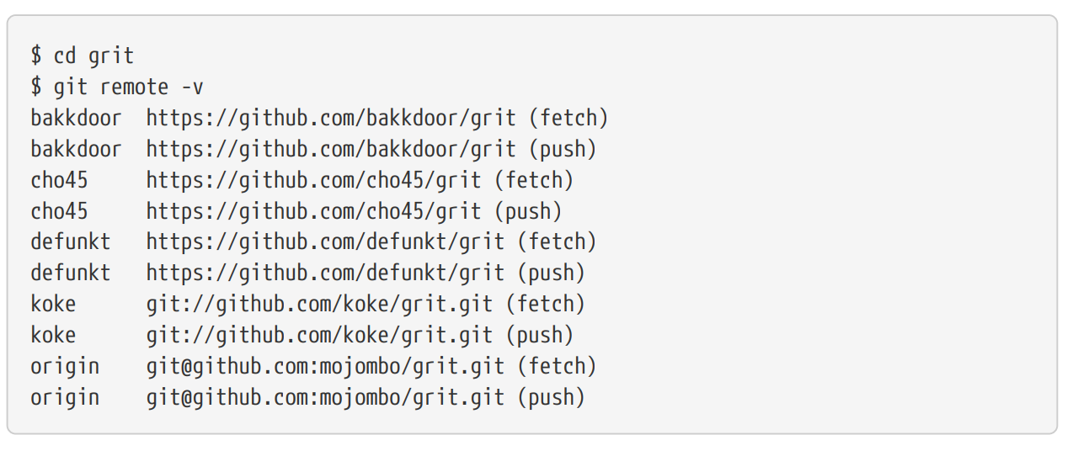
Exercise – Working with Remotes

Slide 54
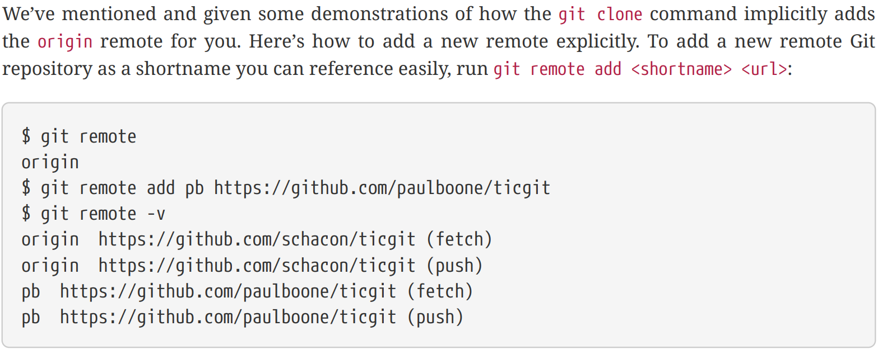
Exercise – Adding Remote Repositories

Slide 55
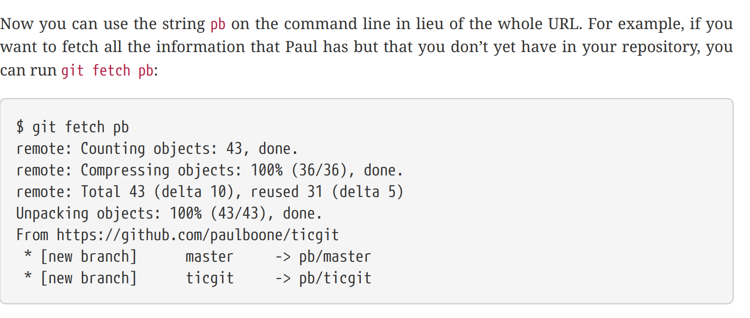
Exercise – Adding Remote Repositories

Slide 56

Fetching and Pulling from Your Remotes

Slide 57
Pushing to Your Remotes

Slide 58

Inspecting a Remote

Slide 59

Renaming and Removing Remotes

Slide 60
Q & A
Thank you for attention
“Coming together is a beginning;
Keeping together is progress;
Working together is success.”
- HENRY FORD

